Slide 1

Microsoft Azure: Digital Transformation and the Hybrid Cloud
Kevin Remde
Sr. Technical Evangelist
Microsoft Corporation

Slide 2
Engage your customers
Transform your products
Digital transformation
Empower your employees
Optimize your operations

Slide 3


GOING DIGITAL
1 million/hour
new devices coming online
by 2020
12 years
average age of S&P 500 corporations
by 2020
60% computing
in the public cloud by 2025

Slide 4
Your Hybrid Cloud world
Cloud
On-Premises

Slide 5
Hybrid Cloud requires consistency
Common Identity
Integrated Management and Security
Consistent Data Platform
Unified Development and DevOps

Slide 6
Microsoft Azure: The consistent Hybrid Cloud
Azure Active Directory
Azure management and security
Azure
data services
Azure services
Clouds
Common Identity
Integrated Management and Security
Consistent Data Platform
Unified Development and DevOps
Active
Directory
On-premises
infrastructure
SQL Server
Azure Stack

Slide 7
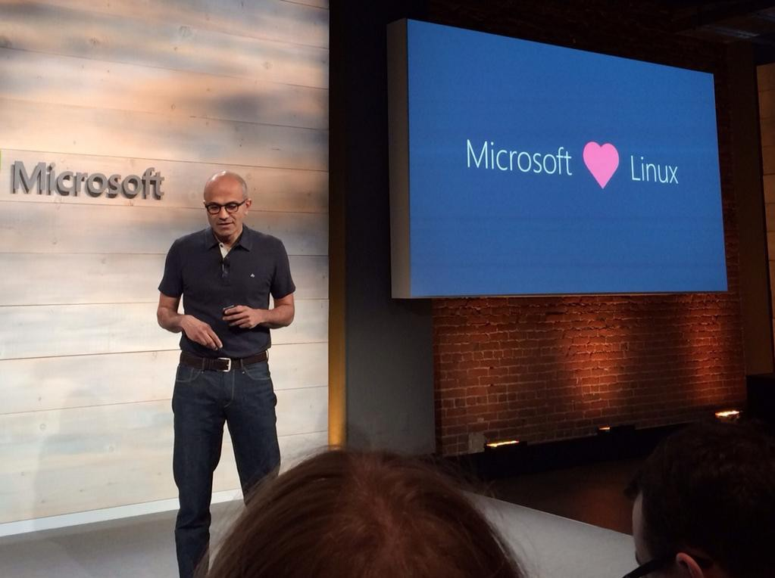
Source: Softpedia
Credits: James Niccolai

Slide 8
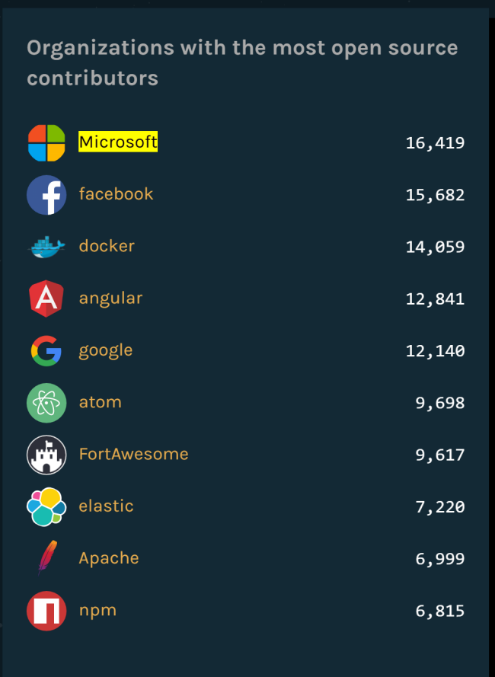

Slide 9






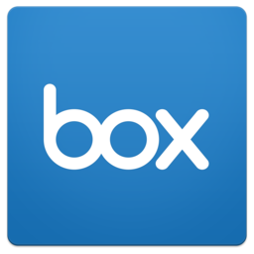











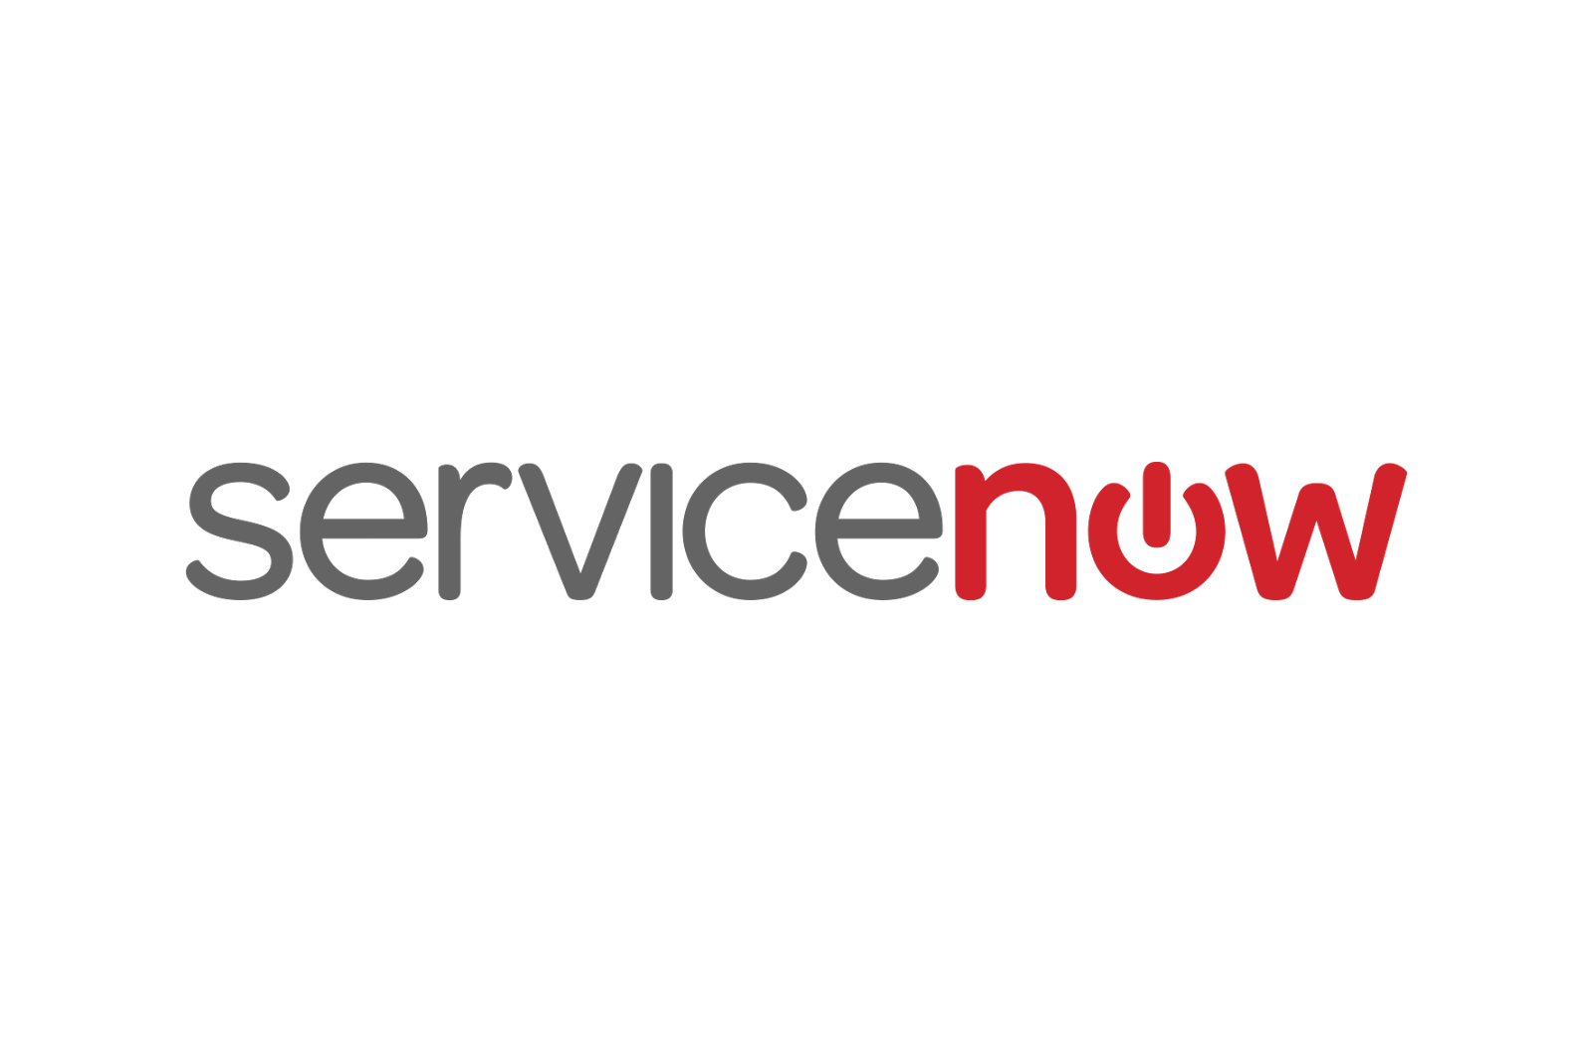




Hybrid + Open
python
Common Identity
Integrated Management and Security
Consistent Data Platform
Unified Development and DevOps

Slide 10








The Market is Embracing Our Open Source Transformation
“I know way too many Linux users who think of Microsoft as ‘The Evil Empire.’ People, that was yesterday. Get over it...Look at Microsoft in 2016 and you'll see a company which offers the open-source Hadoop big data software on Ubuntu and whose CEO proclaims that Microsoft loves Linux.”
“Seeing the words ‘Microsoft’ and ‘Linux’ together in a single sentence may still come as a shock to a few people, but Microsoft says more than 60 percent of images in the Azure Marketplace are now Linux-based.”
“The new Microsoft has taken bold new steps and has been on a path to partner with its fiercest rivals of past years. Strategically, this is what is required to be a player at scale in the cloud platform wars.”
Frederic Lardinois
Al Hilwa, IDC
Steven J. Vaughan-Nichols
“The new Microsoft Certified Solutions Associate Linux on Azure certification <…> It's something of a surprising move, considering that Azure didn't even support Linux virtual machines four years ago, but meshes with Microsoft's current strategy of embracing open source technologies.”
“Even Microsoft, long viewed as the enemy of open-source development, has focused on making its Azure cloud computing platform a hospitable place for open-source software, including different flavors of the Linux operating system.”
“[The Red Hat partnership is] a testament to Microsoft’s ability to rise above product competitiveness and be open, especially when it comes to Azure.”
Eli Khnaser, Gartner
Barb Darrow
Blair Hanley Frank

Slide 11
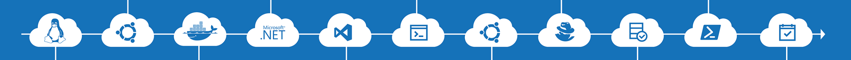
It’s been a journey…
PowerShell is now open source and available on Linux
Linux Agent (GA) & Container Solution (Preview) for Operations Management Suite
Hundreds of contributors to the Azure Resource Manager community on GitHub
…and there’s strong momentum for Linux at Microsoft
4x growth in container customers in Azure since January, all with Docker on Linux!
Over 40% of VMs created in new deployments in Azure today run Linux!
1 in 3 VMs in Azure run Linux today

Slide 12

Microsoft Azure: Global scale
38
Azure regions
More than AWS and Google Cloud combined
RECENTLY LAUNCHED:
US Regions: West US 2 and West Central
Germany – Launched in Sep 2016
United Kingdom – Launched in Sep 2016
NEWLY ANNOUNCED:
France: France Central and France South
Korea: Korea Central and Korea South
DoD East and Central

Slide 13





































Azure Compliance
Azure has the largest compliance portfolio in the industry
Industry
ISO 27001
SOC 1
Type 2
SOC 2
Type 2
SOC 3
PCI DSS Level 1
ISO 27018
CDSA
Motion Picture
Association
Cloud Controls Matrix v3.0.1
(BITS) Shared
Assessments
Japan My
Number Act
Federation Against
Copyright Theft
United States
FedRAMP JAB P-ATO
HIPAA / HITECH
FIPS 140-2
21 CFR
Part 11
FERPA
DISA Level 2
(DIACAP)
CJIS
IRS 1075
ITAR-ready
Section 508 VPAT
FISMA
Regional
Argentine DPA 25.326
European Union
Model Clauses
United Kingdom
G-Cloud
China Multi
Layer Protection Scheme
China
GB 18030
China
TRUCS
Singapore
MTCS Level 3
Australian Signals
Directorate
New
Zealand
GCIO
Japan
Financial Services
ENISA
IAF
Cloud Security Mark Gold
Spanish System Security Plan

Slide 14
Azure momentum
>120K
New Azure customer subscriptions/month
>110B
Azure SQL Database requests/day
9M
Organizations using Azure Active Directory
>3T Messages per week processed by Azure IoT
>4M Developers registered with Visual Studio Team Services
>40%
Revenue from start-ups and ISVs

Slide 15
Azure StorSimple
Azure in Open
Azure Government
Azure SQL Database
Rights Management (RMS)
Azure API Management
Azure Site Recovery
Azure Automation
Instance Level Public Ips
Azure Redis Cache
Azure Batch
Azure Marketplace
Azure Data Factory
Stream Analytics
Event Hubs
Operational Insights
Premium Storage
Virtual Machine Converter 3.0
Cloud Platform System (CPS)
Antimalware for Cloud Services and VMs
Identity Manager vNext
Analytics Platform System (APS)
Visual Studio Community 2013
Visual studio 2015 Preview
.NET 2015
Azure RemoteApp
Azure AD Basic
SSD-based instances for Microsoft Azure VMs and Cloud Services
Azure SQL Database Auditing
Live Channels for Azure Media Services
AAD Application Proxy
New experiences in Power BI
Azure DocumentDB
Azure Search
HDInsight for Storm Public Preview & GA
Azure Zone Redundant Storage
HDInsight for Hbase
WSSC vNext tech preview
Content Protection pub preview
Intune - Nov update and Dec update
Azure AAD premium features
Multi-Factor Auth enhancements
Cloudera and Hortonworks on clustered Azure VMs
Azure Instance level IP
Azure Role Based Access Controls
VPN support pub preview
TiP Testing pub preview
Azure AD Workday A148 Integration
Azure Standard SSG
ExpressRoute S2S, P2S GA
Azure Multiple NICs
Azure Networking Appliances
Azure Traffic Manager Nested policies
Azure VM Image Gallery expansion
Azure Vnet
Azure Web Jobs
VSO datacenter expansion
VSO REST Hooks pub preview
Australia datacenter
Forced Tunneling
WSSC Azure Packs
Azure G-Serves Instances
Azure Key Vault
Drivers for SQL Server
MDM for Office 365 public preview and GA
Azure Media Services Content Protection
Azure Mobile Engagement
Node.js Tools for Visual Studio
Visual Studio 2013 updates
Auto-HA for SQL Server VM
Auto-Patching and Backup for SQL Server VMs
Azure SQL Database Increased Compatibility
Azure AD Connect Health pub preview
Azure AD MFA Per App / Conditional access pub preview
Azure RMS controlled user deployment
Azure RMS departmental templates pub preview
Azure Site Recovery SAN Replication
ASP.NET 5 Preview
Azure SDK 2.5.1
Team Foundation Server 2015 preview
Azure Machine Learning GA
Azure HDInsight for Linux Pub Preview
Azure HDInsight Support for Hadoop 2.6 pub preview
Azure SQL Database security feature - Data Masking pub preview
Azure SQL Database security features - Encryption
Azure SQL Database security features - Row Level security
Azure AD: API for SIEM
Microsoft Intune monthly updates
Remote Desktop Client for Windows Phone 8.1
Azure App Service
Azure CDN Integration
Azure Media Encoder Premium
Azure AD Premium & Basic in CSP
Azure IoT Suite
Windows Server Containers
Hyper-V Containers
Windows Server Nano Server
Azure Media Player GA
Azure Service Fabric
Azure IoT Suite
Azure Site Recovery: Protect VMWare and Physical Servers in Public Preview
Azure Backup Generally Available
Azure API Management Premium simplifies high availability and massive scale for APIs
ExpressRoute for Office 365
Azure Active Directory Dynamic Membership For Groups
Automatic Password Change for Social Media Shared Accounts
Compute-Intensive A10 and A11 Virtual Machine Instances
Remote Desktop app for Windows Phone support for Gateway and Remote Resources
Informatica Cloud Agent availability in Linux and Windows Virtual Machines
Azure DocumentDB Hadoop Connector
Azure HDInsight support for more VM sizes
Enterprise-Grade Array-Based Replication and Disaster Recovery with ASR and System Center GA
500+
New releases in
the last 12 months

Slide 16



















































Azure services across IaaS and PaaS
http://azureplatform.azurewebsites.net/
Azure Platform Services
Security & Management
Compute
App Services
Developer Services
Hybrid
Operations
Cloud
Services
Service
Fabric
Web Apps
API
Apps
API
Management
Visual Studio
Azure SDK
Portal
Azure AD
Connect Health
Batch
Remote App
Mobile
Apps
Logic
Apps
Notification
Hubs
Team Project
Application
Insights
Active
Directory
AD Privileged
Identity
Management
Multi-Factor
Authentication
Integration
Analytics & IoT
Data
Backup
Storage
Queues
Biztalk
Services
Automation
HDInsight
Machine
Learning
SQL
Database
SQL Data
Warehouse
Operational
Insights
Hybrid
Connections
Service
Bus
Key Vault
Data
Factory
Event
Hubs
Redis
Cache
Search
Import/Export
Store /
Marketplace
Media & CDN
Site
Recovery
Stream
Analytics
Mobile
Engagement
DocumentDB
Tables
VM Image Gallery
& VM Depot
Media
Services
Content Delivery
Network (CDN)
StorSimple
Azure Infrastructure Services
Virtual Machines
Storage
Networking
Windows
Linux
Containers
BLOB Storage
Azure Files
Premium Storage
Virtual Network
Load Balancer
DNS
Express
Route
Traffic Manager
VPN Gateway
Application Gateway

Slide 17
Azure Services to create intelligent solutions
INFORMATION MANAGEMENT
BIG DATA STORES
MACHINE LEARNING AND ANALYTICS
INTELLIGENCE
Data Sources
Cognitive Services
People
Data Factory
Data Lake Store
Machine Learning
Bot Framework
Web
Data Catalog
SQL Data
Warehouse
Data Lake Analytics
Apps
HDInsight
(Hadoop and Spark)
Cortana
Mobile
Event Hubs
Apps
Bots
Stream Analytics
DASHBOARDS & VISUALIZATIONS
Sensors and devices
Automated Systems
Power BI
DATA
INTELLIGENCE
ACTION

